Slide 1
Telesciences/ Geoscience:
Shinji Shimojo, Fang-Pang Lin, Sornthep Vannarat
Pragma 27

Slide 2
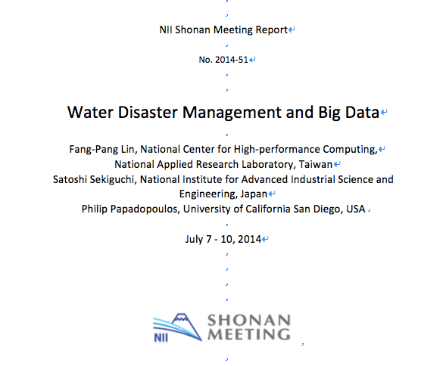

Slide 3
Notes:
typhoon, land slide, earth quake, tornade, flooding

Slide 4
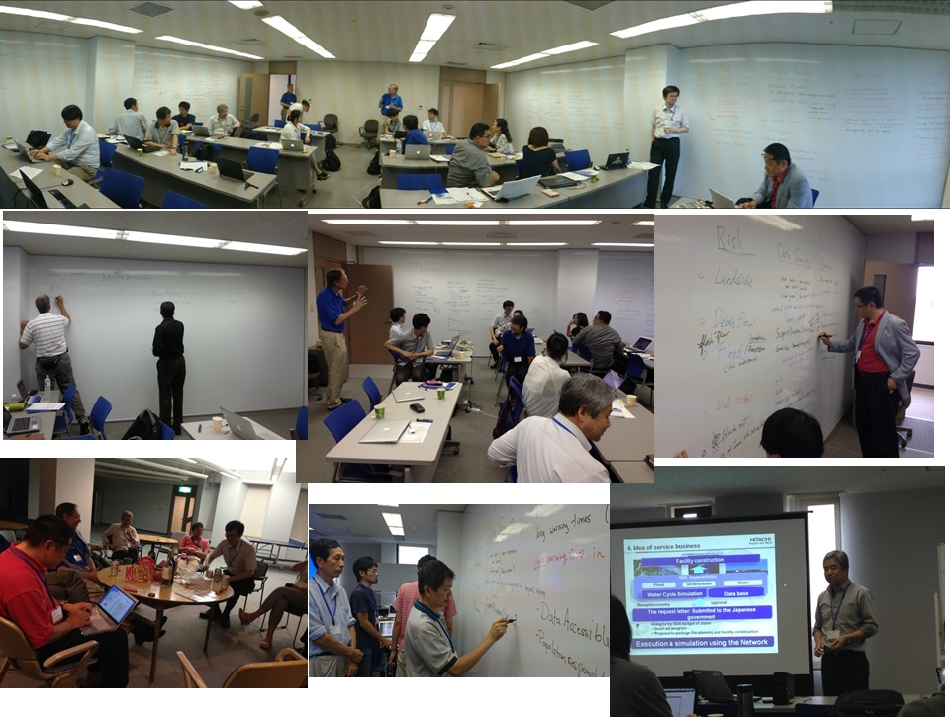

Slide 5
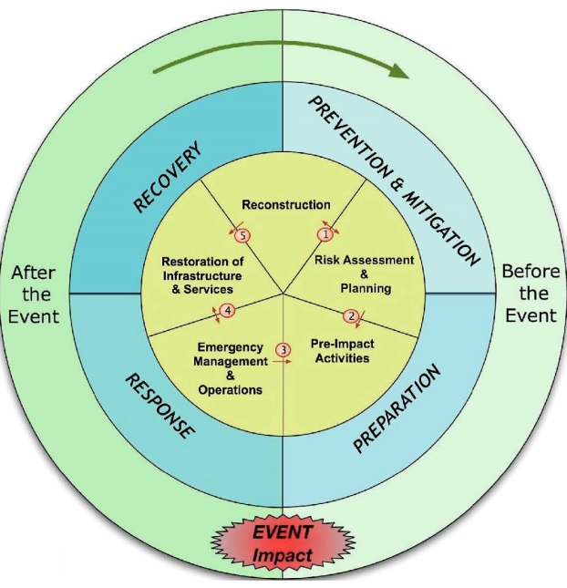
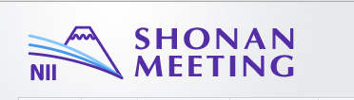
Water Disaster Management and Big Data Phases in Disaster Management
Quick or Slow onset
Monitoring, predicting, communicating and responding
From Earthzine (http://www.earthzine.org/disaster-management-theme/). Vanneuville et all, posted March 21, 2011

Slide 6
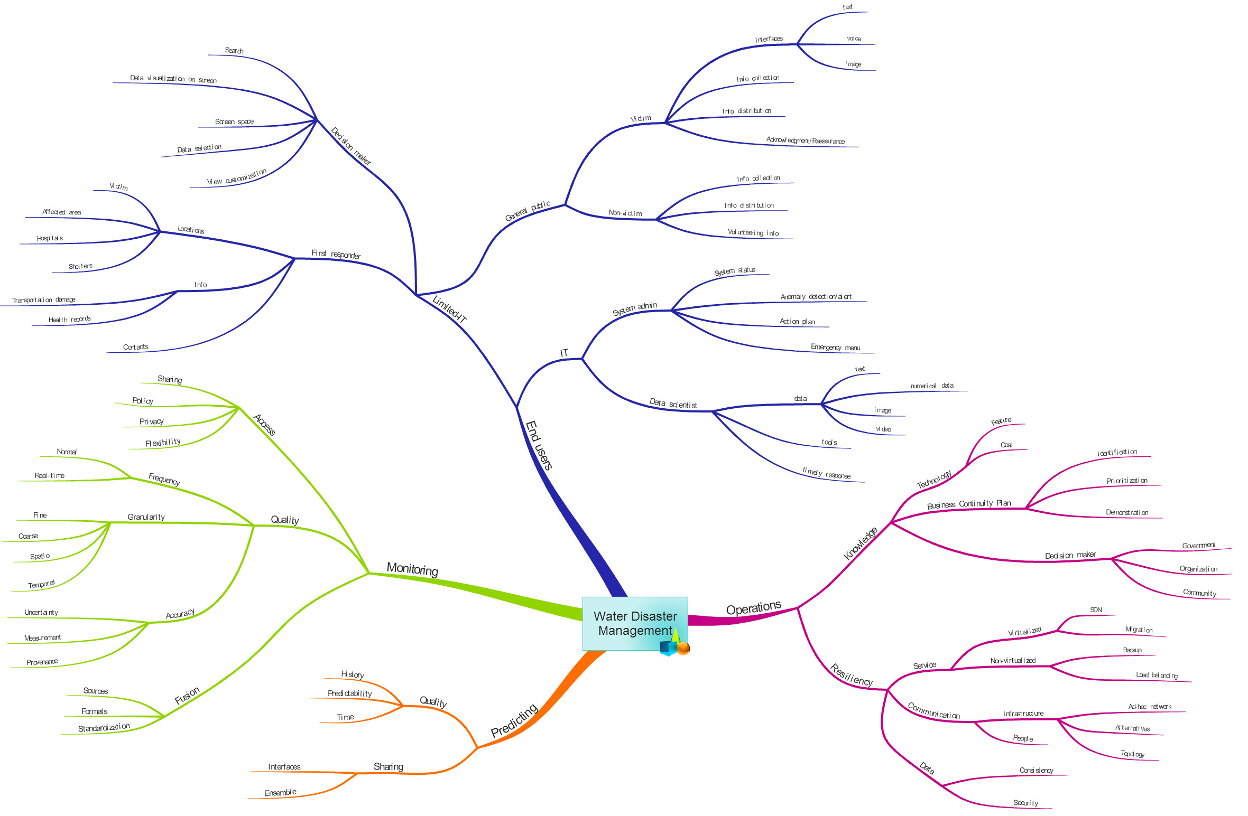
Understand the Real Problems of Disaster Managment
Made by Prapaporn Rattanatamrong, Jason Haga and Kyong-Sook Kim

Slide 7
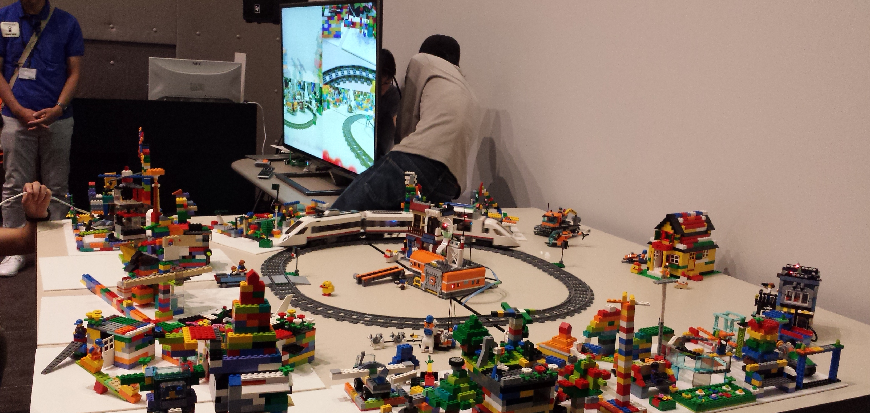
Collaboration with Kobe Institute and the Lab
Interactive model for the railroad museum Nicole Wong

Slide 8
day 1
Nor Arlina Amirah Ahmad Ghani, Nurul Shakina Mohd Talkah, Shaiful Rahim, Iylia Zulkifli, Parveendeerjeet Kaur Bal, Mohd Shahir Shamsir Omar, “Implementing Citizen Science in Biodiversity Conservation: A Case Study of EcoSabah Android Application Reporting Solution for Species Occurrences in Sabah, Malaysia”
Dr. Jongsung Lee, “Ergo: Open Source Platform for Multi-Hazard Assessment, Response and Planning.”
Fang-Pang Lin, “Report of shonnan meeting for water disaster mitigation”

Slide 9
Discussion
citizen based science
gamification, quality control
Ergo: risk management system
More collaboration opportunity
Shonan meeting
Tsunami, Flood, Typhoon
SEIAP on Dec.

Slide 10
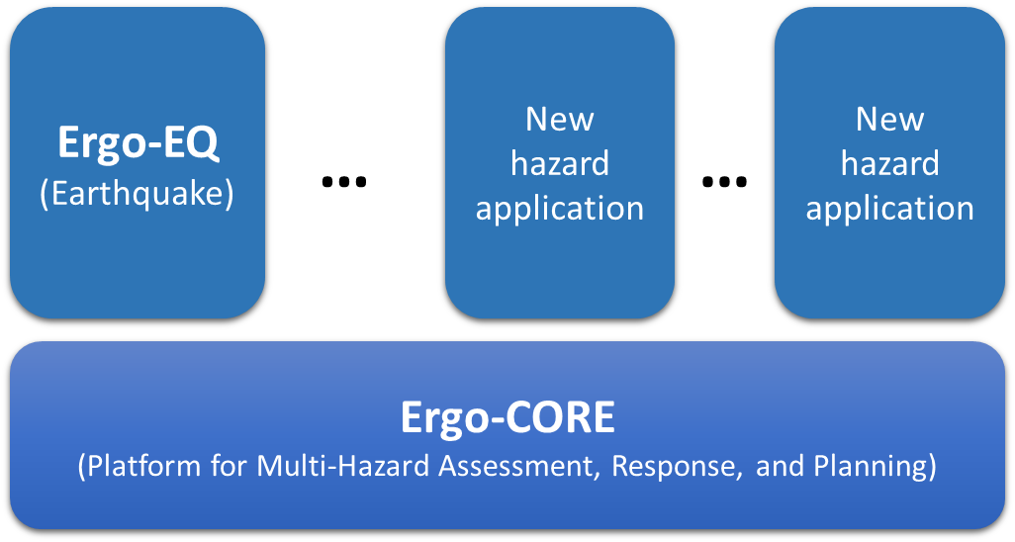
Ergo: IT Framework
Ergo: An IT Framework based on Consequence-based Risk Management (CRM) principle.
Semantically-aware System
Spatially-enabled System
Extensible System

Slide 11
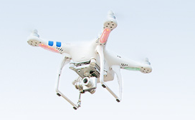
day 2
Dr. Wen-Yii Chang "A River Basin-based Real-time Bridge Safety Warning System"
Yoshiyuki Kido, “Tiled Display Wall using Openflow to avoid failure”
All VM based disaster Mitigation center on Pragma-ENT
For Service Continuity
Live Migration demo on SC14 collaboration with Resource WG
extend to Taiwan with Satellite data
Distributed AUVs
DJI Phantom 2
more CPS (Cyber Physical System)
More Discussion on SEAIP

Slide 12
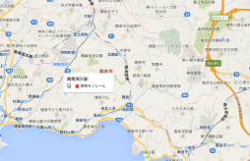
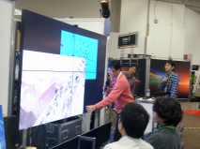


Group2: short-term goal?
Building a MAP I/F using multiple tiled display wall on PRAGMA ENT
Where we can look at shared map
Where we can ..
MAP visualization
Geo, time-referenced data visualization
Population Data
Selects geo,time-referenced data
to over lay
synthesizer
Inter-site SDN
Inter-site SDN
controller
how to divert
water?
decision maker
flooding area
over time?
population around
this area?
collaboration
decision maker
collaboration
decision maker
Fang-Pang Lin

Slide 13
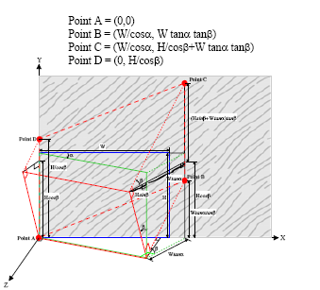
Laser-positioning PIV (1)
Concept: Using Laser points projected on water surface as reference scale for PIV (Particle Image Velocimetry)
Bridge
Camera
Laser Projector
Laser point position
Flow

Slide 14


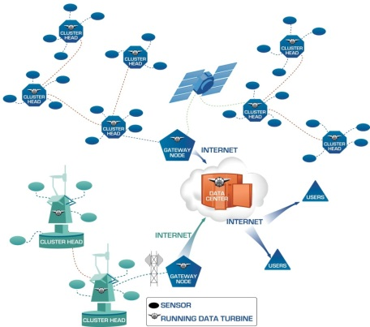
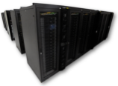
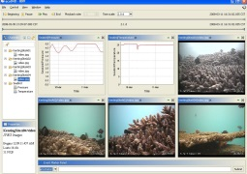

Future Collaboration in Big Data service: Service Continuity through Virtual Data Centers
Sensor Networks:
Data Sources
Virtual Data Center
Virtual Data Center (backup services)
Data Flow
by Phil Papadopoulos

Slide 15
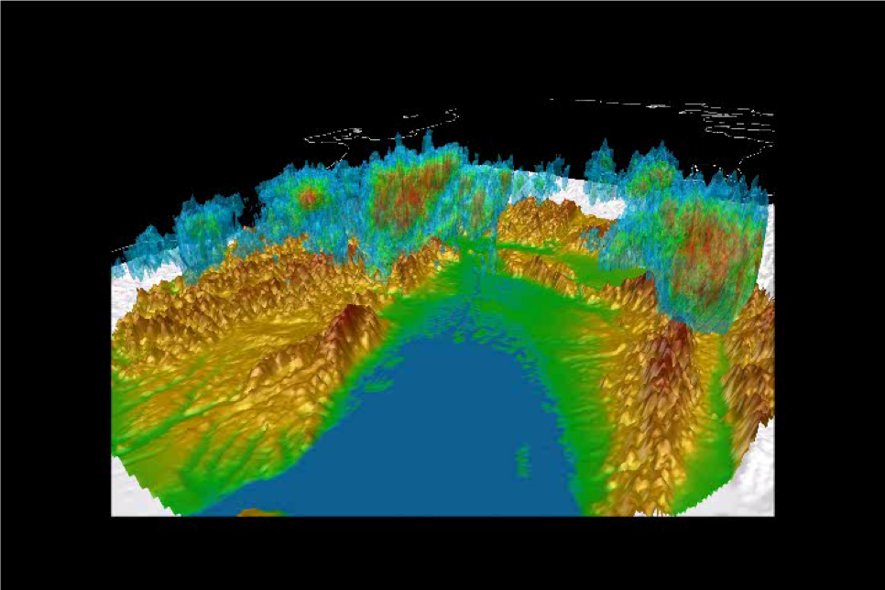
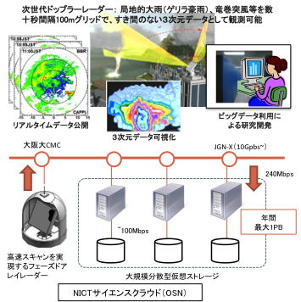
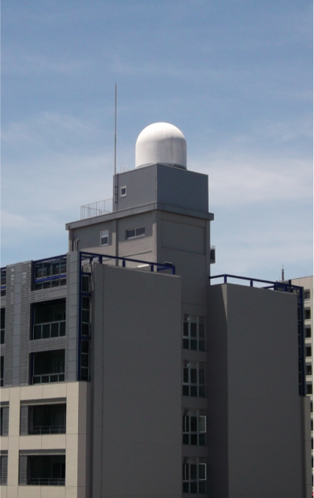

Slide 16
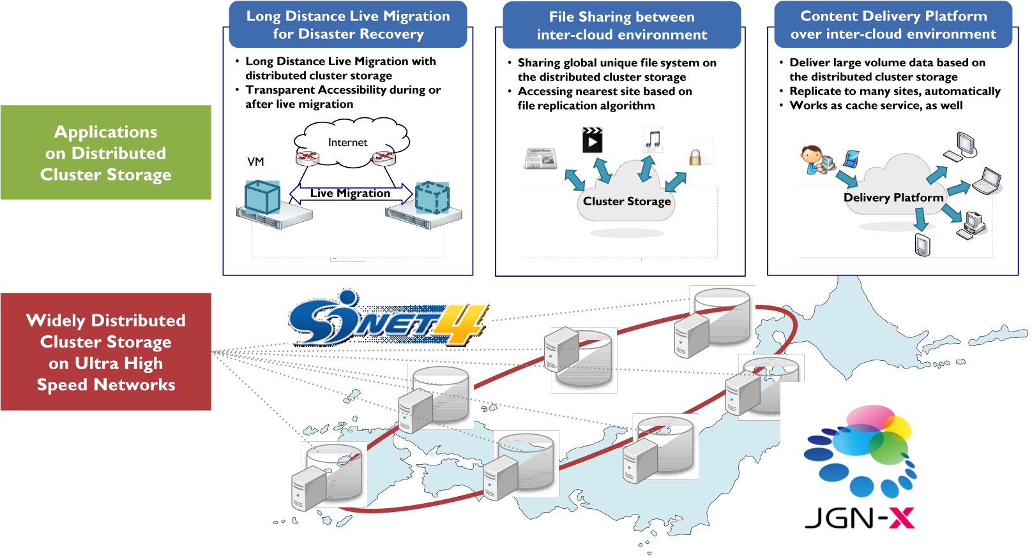
Distcroud (SC13) by Nakagawa

Slide 17
Tainan Science Park & Kaohsiung Si Zi Wan beach.
1-5, December 2014

